Slide 1
Sentimental Analysis for Hotel Review
Mini Project – 1 (BTCOM507)
Prajwal Gurnule (2146491245011)
Pranav Ikhar (2146491245009)
Renuka Kothekar (2146491245016)
Ritika Bhonge (2146491245003)
Mr. Amol Jumde
Assistant Professor

Slide 2
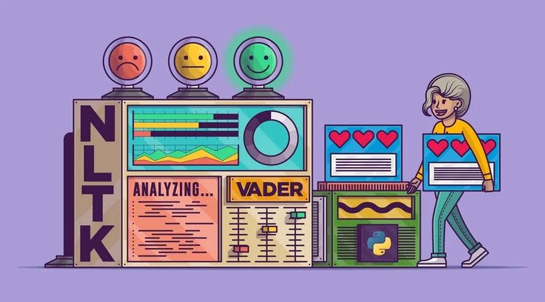
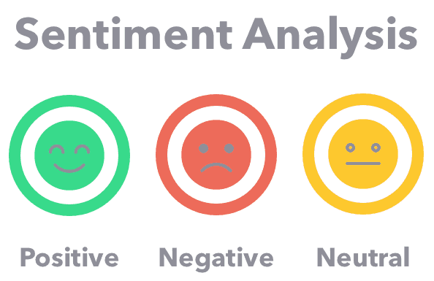
1. Introduction
Trip advisor shows that 81% of travelers read reviews before booking a hotel.
Hotel reviews provide valuable information about a hotel's reputation, and Sentiment Analysis (SA) is increasingly important.
SA captures positive or negative sentiments from a dataset using Natural Language Processing and Machine Learning to analyze customer perceptions,.
This type of examination is also called Opinion Mining or Emotional AI.

Slide 3
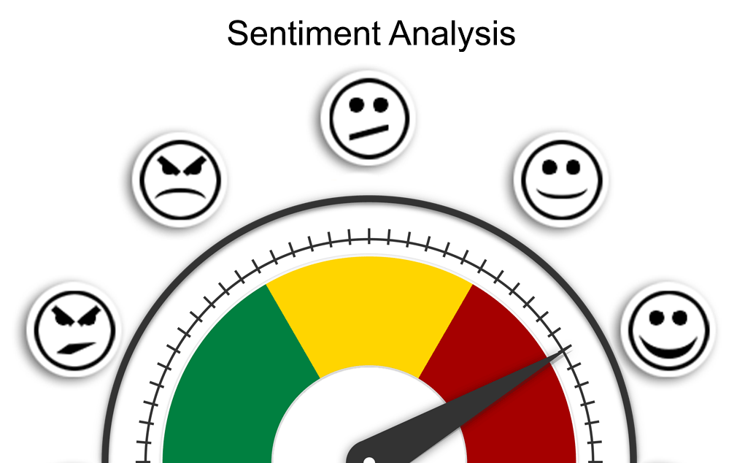
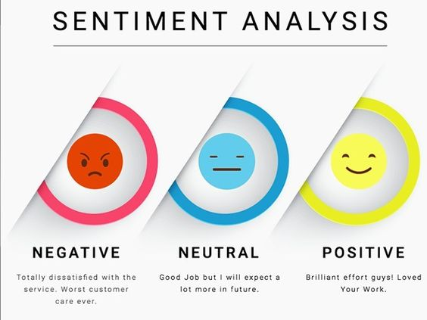
2. Objectives & Scope of Project
The primary objective of this project –
to develop a sentiment analysis model that can accurately discern the sentiment behind text data, whether it's a short tweet, a lengthy product review, or a news article.
to help travelers make better decisions by providing them with a summary of the positive and negative aspects of different hotels based on the feedback from previous guests.
The goal of this project is to build unsupervised Natural Language Processing (NLP) machine learning models that decide whether a text review is positive review or negative review. This project, will help hotels to determine the category of text review and cluster them automaticity to improve their services.

Slide 4



3. Stakeholders
Hotel Owners /
Management
Online Review
Platforms
Travelers /
Customers

Slide 5
4. Literature Survey.
Sr. No. | Paper Details | Work reported
1. | Hegde, Y., and S. Padma. 2017. “Sentiment Analysis Using Random Forest Ensemble for Mobile Product Reviews in Kannada.” In 2017 Ieee 7th International Advance Computing Conference (Iacc), 777–82. Los Alamitos, CA, USA: IEEE Computer Society. https://doi.org/10.1109/IA CC.2017.0160. | An overview of a review management tool is shown where a variety of hotel comments were collected, in order to hark the visitors’ points and views of the hotel quality.
2. | Dey, Lopamudra, Sanjay Chakraborty, Anuraag Biswas, Beepa Bose, and Sweta Tiwari. 2016. “Sentiment Analysis of Review Datasets Using Naive Bayes and K-Nn Classifier.” ArXiv abs/1610.09982. | The study focused on the initial stage of the algorithm by answering the research question that can the Bidirectional Encoder Representations from Transformers model determine whether a customer's review on Yelp is positive or negative, and the degree of said positivity or negativity, based on the review's content.
3. | Rennie, Shih, J. D. M. n.d. “Tackling the Poor Assumptions of Naive Bayes Text Classifiers.” In Twentieth International Conference on Machine Learning, 616–23. Washington, DC: Goole Scholar. https://www.aaai.org/Papers/ICML/2003/ICML03-081.pdf | This study’s purpose was to identify factors of usage, trust, influence, and contribution of restaurant reviews on Yelp.com. This study found that information search reduction and community membership were the greatest factors encouraging Yelp.com use
4. | Boya Yu, Jiaxu Zhou, Yi Zhang, Yunong Cao “Identifying Restaurant Features via Sentiment Analysis on Yelp Reviews” Center for Urban Science & Progress New York University, New York, The United States. | The main approach used in this paper is to use a support vector machine (SVM) model to decipher the sentiment tendency of each review from word frequency. Word scores generated from the SVM models are further processed into a polarity index indicating the significance of each word for special types of restaurants. Customers overall tend to express more sentiment regarding service.

Slide 6
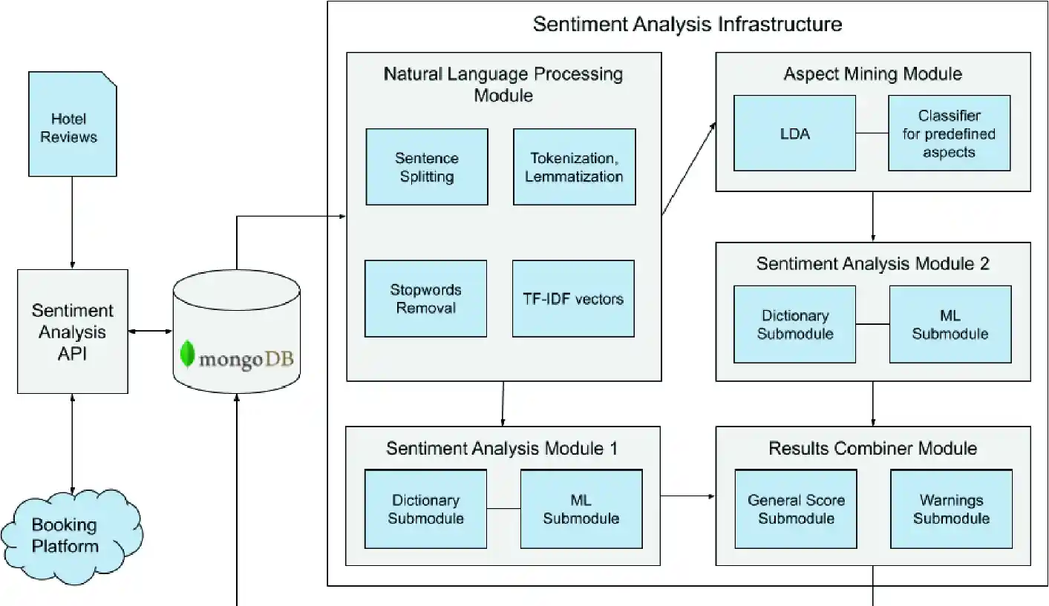
5. System Architecture
Dataset
Fig. 1 : Hotel reviews sentiment analysis’ platform architecture [5]

Slide 7
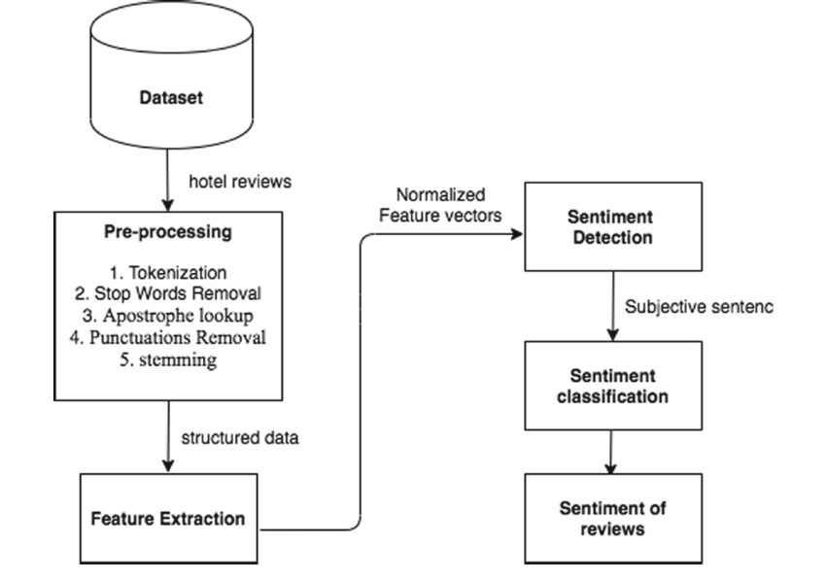
6. Proposed Solution
Fig. 2 : The proposed system [6]

Slide 8
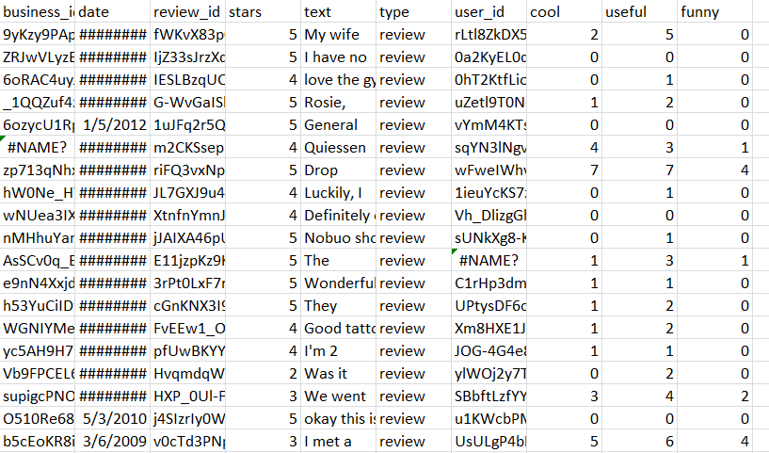
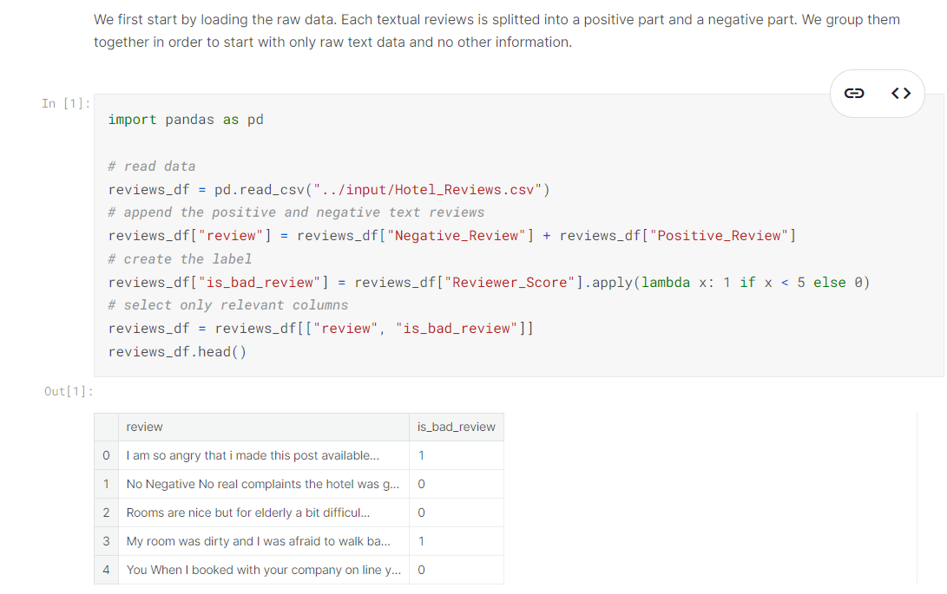
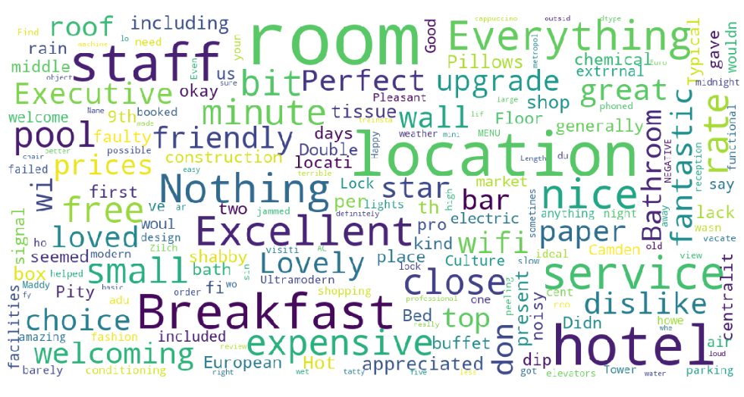
DataSet

Slide 9
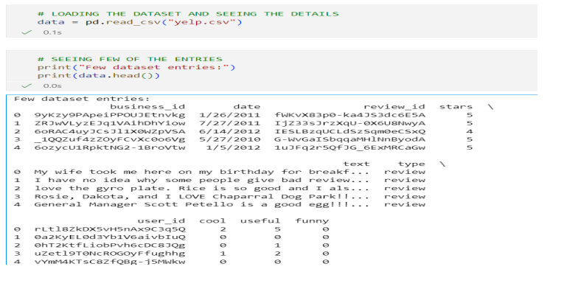
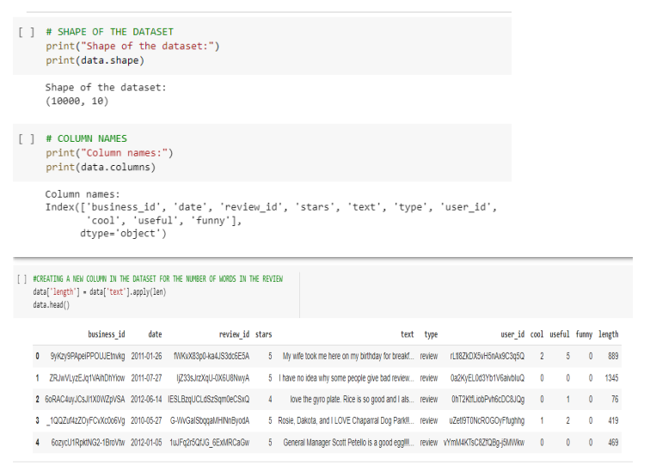
7. Implementation
Dataset Pre-processing :We first write some basic Python commands for exploratory data analysis on the data. Also created a column named ‘length’ to calculate the number of words in a review.

Slide 10
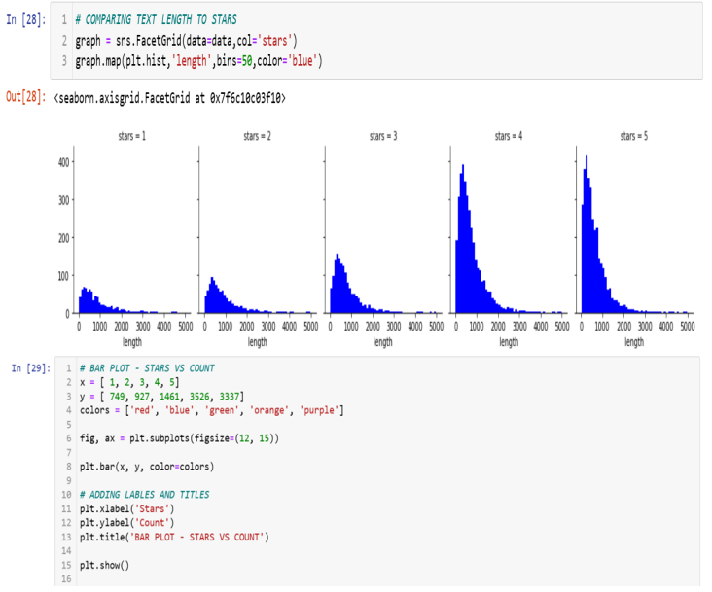
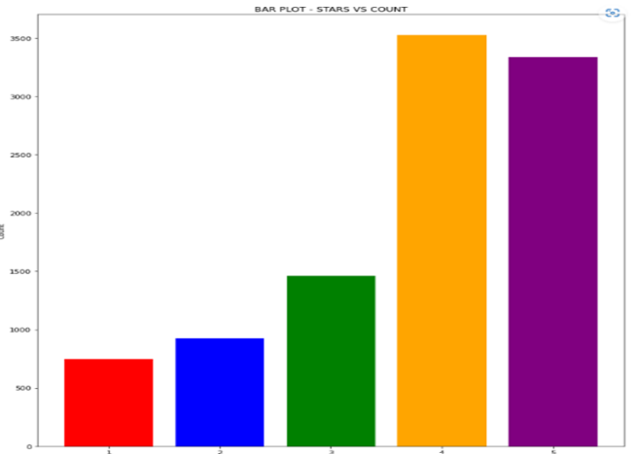
Implementation
We carried out some visualization methods to better understanding of data :

Slide 11
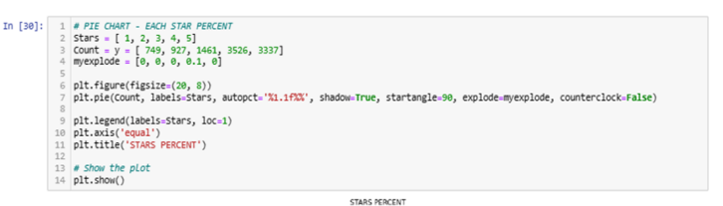
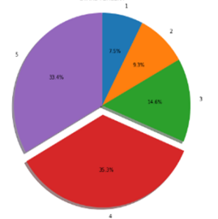
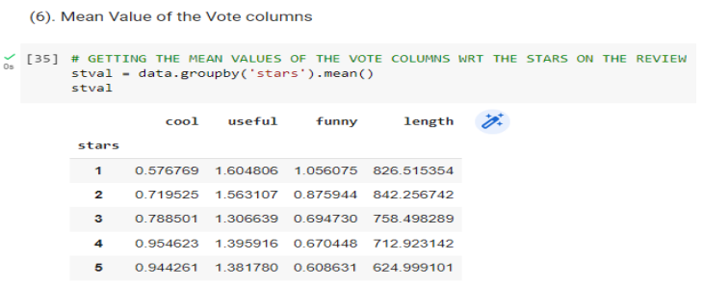
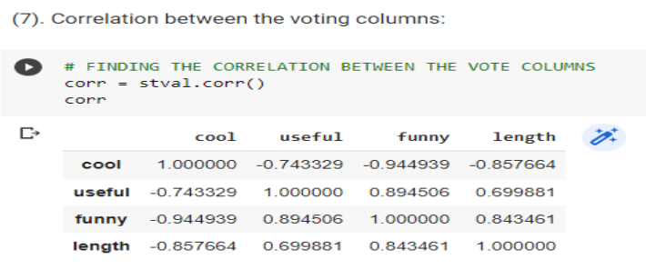
Implementation
Creating a bar plot for average ratings vs month and average words vs stars. We have found out the mean value (stval) of the vote columns w.r.t the stars on the review and also the correlation (corr) between the vote columns.

Slide 12
8. Models and Algorithms Used
K – Neighbors
Classifier
Random Forest
Classifier
Multinomial
Naive
Bayes
Decision Tree Classifier
Support Vector Machine
(SVM)
MULTILAYER PERCEPTRON

Slide 13







9. Technologies Used

Slide 14
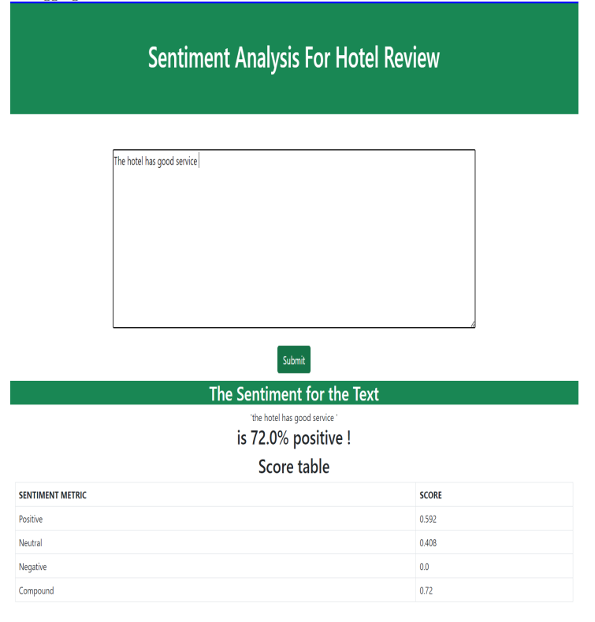
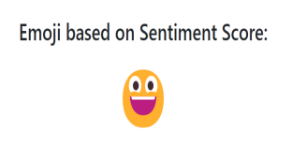
10. Demonstration
5
We created a Flask application that leverages natural language processing libraries such as NLTK and VADER Sentiment for sentiment analysis.
The results, including the compound sentiment score, positive sentiment score, negative sentiment score, and the processed text, are then displayed on the web page. The application is designed to run locally on the server at http://127.0.0.1:5002/ with debugging enabled.

Slide 15
11. Project Timelines
5
Collecting and preprocessing a dataset of hotel reviews.
TASK 1
Performing exploratory data analysis to understand the distribution and characteristics of the reviews
TASK 2
Choosing and applying a word embedding technique to convert the text into numerical vectors that can be used by machine learning models.
TASK 3
Selecting and training a sentiment analysis model to classify the reviews into positive, negative, or neutral categories.
TASK 4
Evaluating the performance of the model using metrics such as accuracy, precision, recall, and F1-score.
TASK 5
Visualizing and presenting the results of the sentiment analysis in a clear and informative way
TASK 6

Slide 16

12. Conclusion
The best way to know if a hotel is right for you or not is to find out what people are saying about the hotel who have stayed there before. This is where the task of hotel reviews sentiment analysis can help you decide whether or not a hotel is suitable for your trip.
Sentiment Analysis is proving to be a valuable technology as it helps businesses process huge amounts of unstructured data in an efficient and cost-effective way.
Organizations wishing to make their product or service better, drive more sales, and outsmart their competitors should utilize sentiment analysis. Talk to our experts to know more.
A future enhancement could involve developing a recommendation system that uses sentiment analysis to suggest hotels based on customer preferences.

Slide 17
12. References
For an Article in a Journal :
[1] Hegde, Y., and S. Padma. 2017. “Sentiment Analysis Using Random Forest Ensemble for Mobile Product Reviews in Kannada.” In 2017 Ieee7th International Advance Computing Conference (Iacc), 777–82. Los Alamitos, CA, USA: IEEE Computer Society. https://doi.org/10.1109/IA CC.2017.0160.
[2] Dey, Lopamudra, Sanjay Chakraborty, Anuraag Biswas, Beepa Bose, and Sweta Tiwari. 2016. “Sentiment Analysis of Review Datasets Using Naive Bayes and K-Nn Classifier.” ArXiv abs/1610.09982.
[3] Rennie, Shih, J. D. M. n.d. “Tackling the Poor Assumptions of Naive Bayes Text Classifiers.” In Twentieth International Conference on Machine Learning, 616–23. Washington, DC: Goole Scholar. https://www.aaai.org/Papers/ICML/2003/ICML03-081.pdf
[4] Sharif, Omar, Mohammed Hoque, and Eftekhar Hossain. 2019. “Sentiment Analysis of Bengali Texts on Online Restaurant Reviews Using Multinomial Naïve Bayes.” In, 1–6. https://doi.org/ 10.1109/ICASERT.2019.8934655.
Dataset Reference:
https://www.kaggle.com/code/omkarsabnis/sentiment-analysis-on-the-yelp-reviewsdataset/input

Slide 18
Thank You..

